Slide 1
Neural Network & Reinforcement Learning
田鹏超
tianpch@shanghaitech.edu.cn

Slide 2
Neural Network

Slide 3
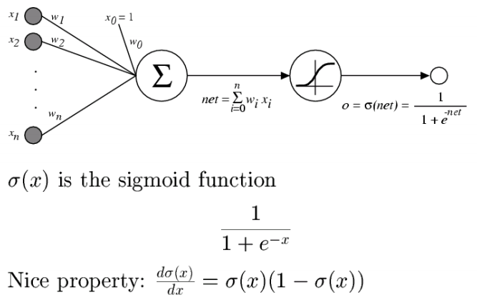

Slide 4
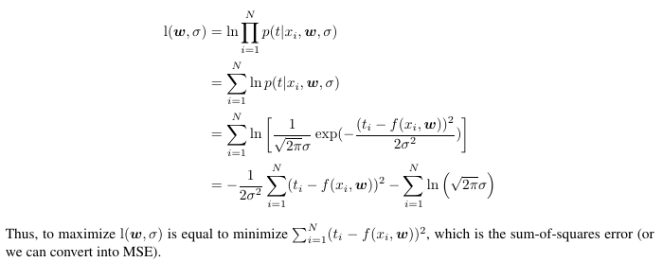
MLE and MSE (Lecture21，p8)

Slide 5
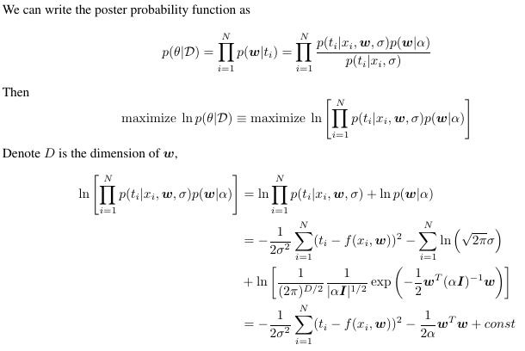
MAP and regularized MSE (Lecture21，p9)

Slide 6
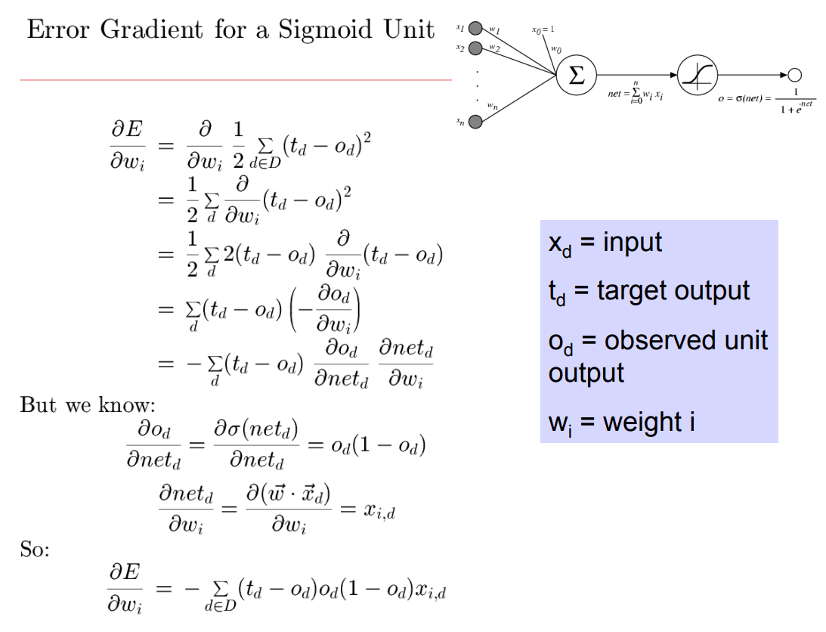
Backpropagation (MLE v.s. MAP)

Slide 7
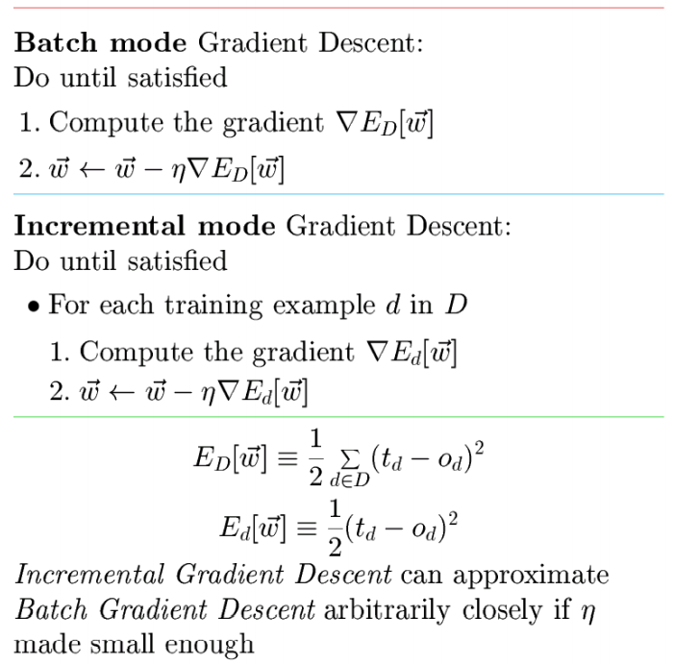
Batch GD, SGD, Mini-batch GD

Slide 8
Reinforcement Learning

Slide 9
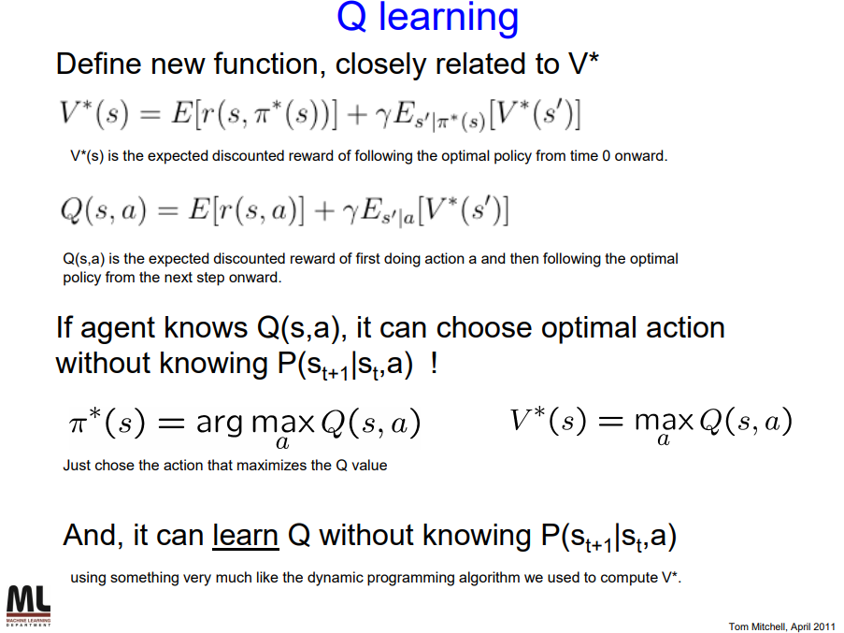
Value function & Q-Learning

